Slide 1

Introduction to Quantitative Proteomics
October 20th, 2022
Angie Mordant

Slide 2
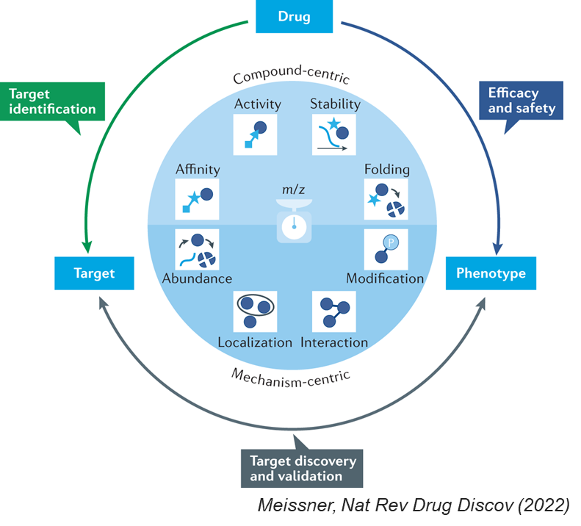
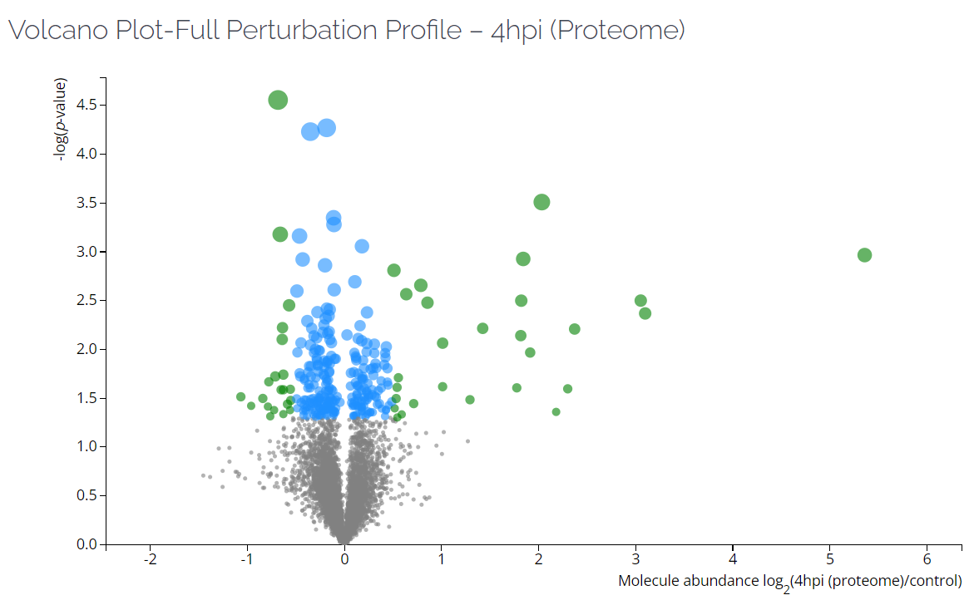
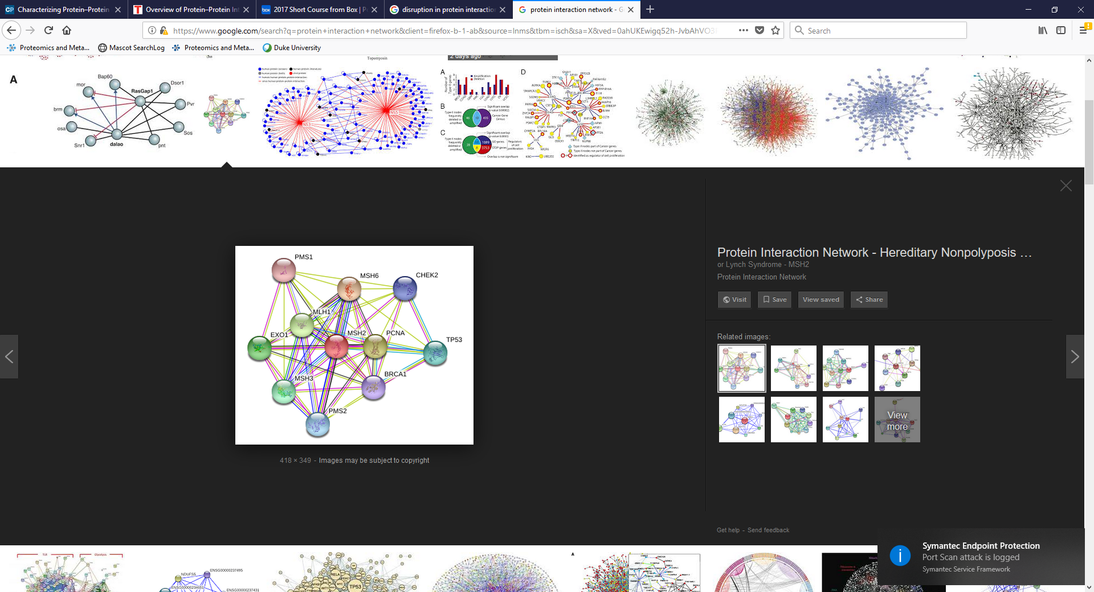
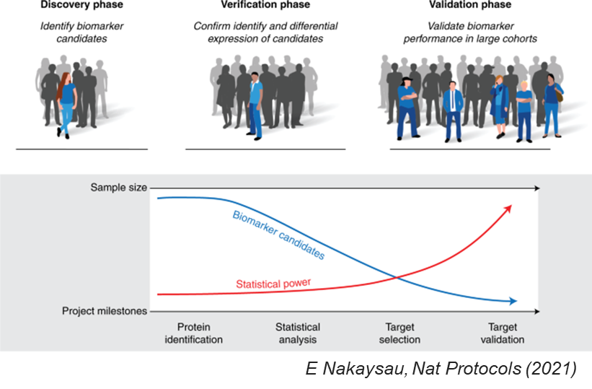
PROTEOMICS
Drug discovery
Identify, quantify, and characterize proteins from biological samples
Quantitative proteomics
Protein-protein interactions
Biomarker discovery
& validation
Post-translational modifications
Slide modified from Dr. Laura Herring

Slide 3
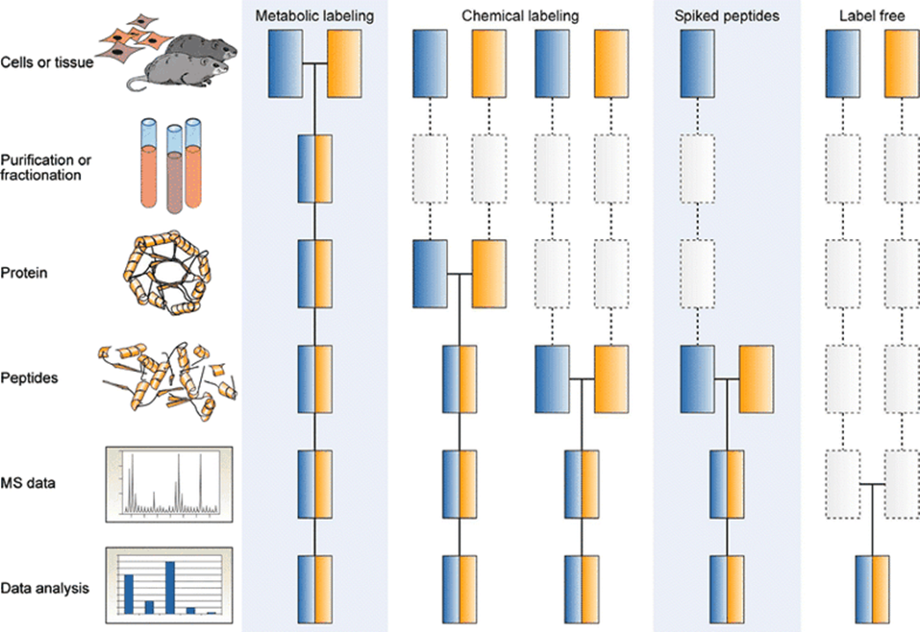
Global Quantitative Proteomics
AIM: Identify and quantify all proteins that are expressed in a sample at a given time
Quantification is relative
Comparison(s) of one or more condition(s) to a control, e.g.:
What proteins are significantly altered in diseased samples compared to healthy controls?
What sputum proteins may be upregulated following woodsmoke exposure?
No hypothesis required
Different approaches to quantitate proteomics
LFQ*
Spectral counts
/ Area under the curve
Tandem mass tags (TMT)
Kuster et al. Analytical and Bioanalytical Chemistry 2007

Slide 4
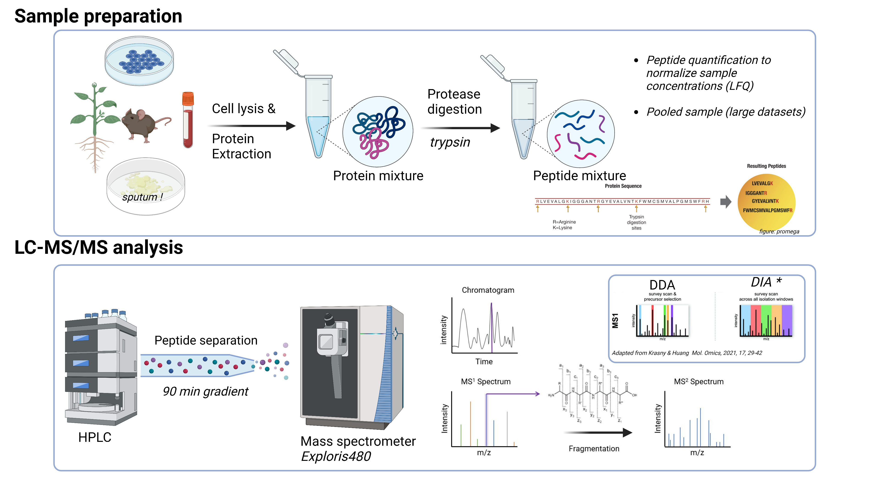
Global Quantitative Proteomics – Workflow

Slide 5

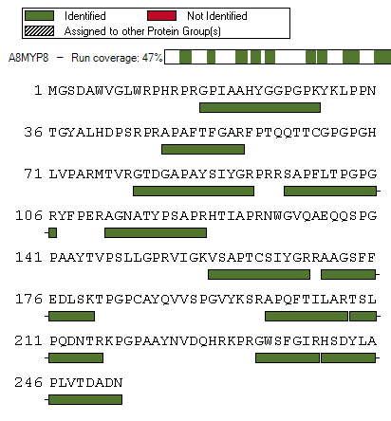
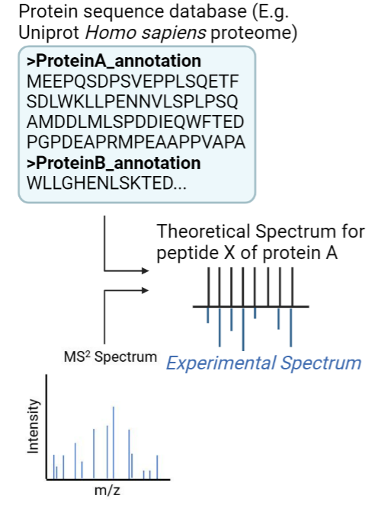
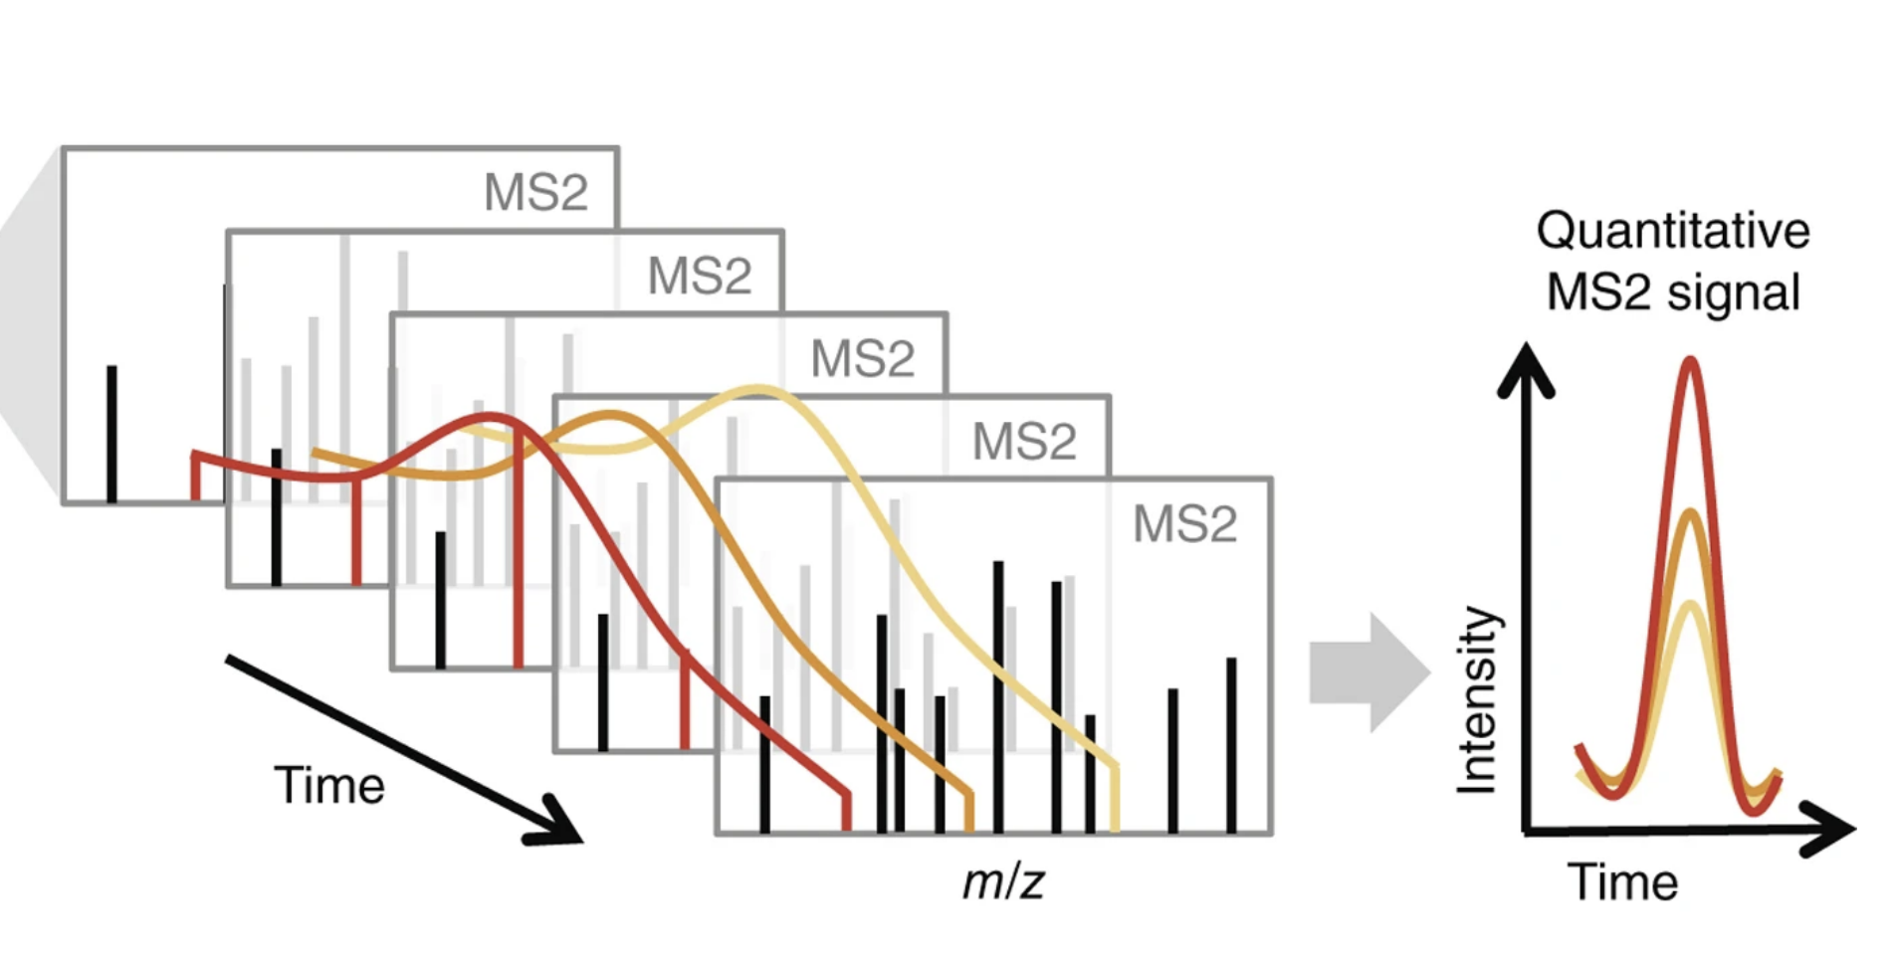
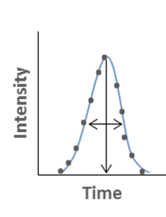
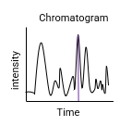
Global Quantitative Proteomics – Data processing
Protein identification
Protein quantification
Spectral counts; peak intensities / areas
“Bottom – up” approach
Shubert et al. Nature protocols (2017)
Example from PC1000-Jaspers - ODF3B
“Area under the curve”

Slide 6
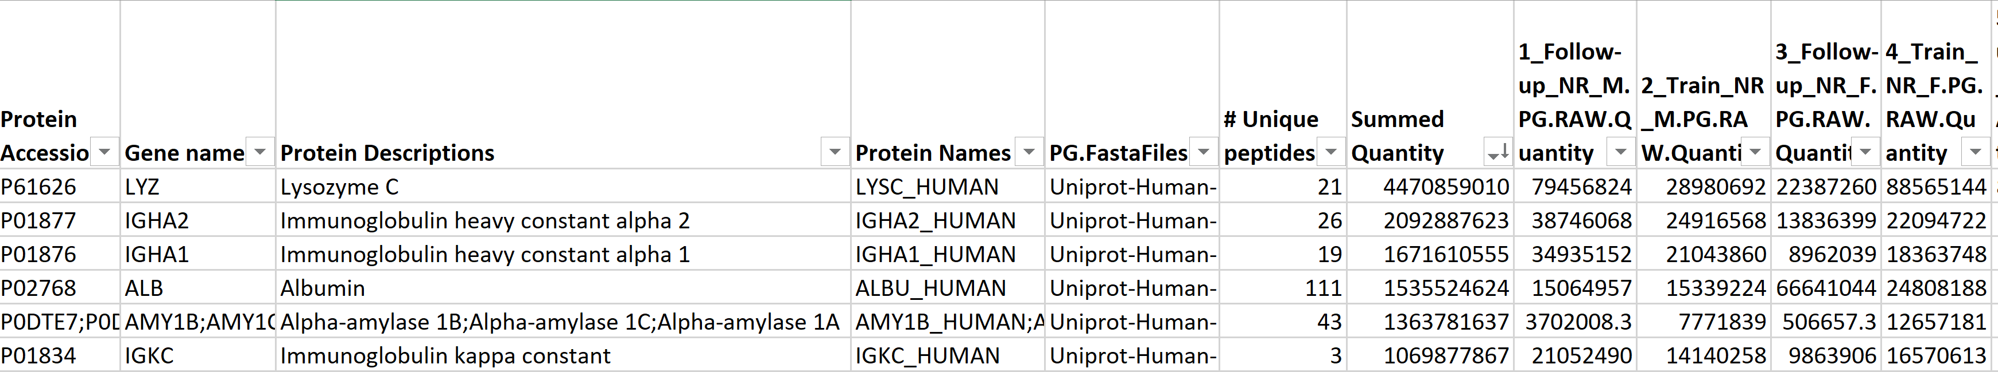

Data Interpretation - example
Number of peptides that map to this protein only
Summed abundances across all samples
Relative abundances in each sample
(based on areas under the curve)
Protein identifiers, based on Uniprot annotation

Slide 7

Questions?
Website: med.unc.edu/proteomics/

